Slide 1
Lab 2
Language Models
Prepared by:
Omar Samir

Slide 2
Lab Outcomes
Implement Language Models from scratch
Bi-gram Language Model
RNN Language Model
Applications of Language Models
Predicting randomly masked words
Generating new sentences

Slide 3

Language Models
A language model is a model that predicts some word w given some history of words h by computing the following formula
By calculating this formula for all possible words, we can determine the most possible words.

Slide 4



Bi-gram Language Model
The bi-gram LM makes this approximation
This probability can be calculated just by counting frequencies
With add-one smoothed bigram our final equation will be

Slide 5
Bi-gram Language Model
To implement it we need to do the following:
Create the bi-gram matrix of size |V| * |V| where |V| is the size of vocabulary
Loop over sentences to create all possible bi-grams
Use these counts to fill the matrix
To calculate the probability we can use the matrix we constructed with the add-one smoothed formula

Slide 6
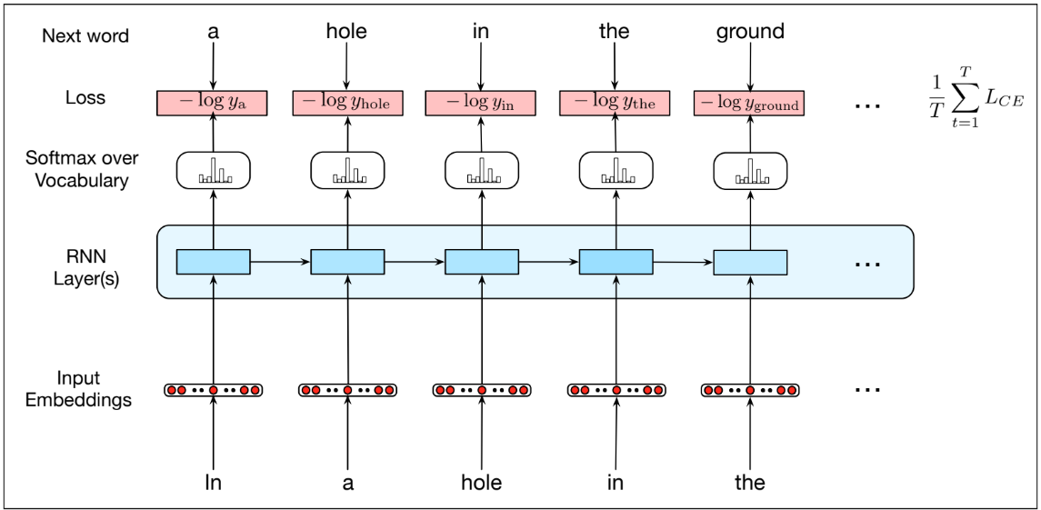
RNN Language Model

Slide 7
RNN Language Models
Since we need to work with matrices and vectors, we need a library that does the basic matrix operations.
The library we will use is numpy which contains all matrix operations we need
>>> import numpy as np
>>> np.dot()
>>> np.sum()
>>> np.exp()
>>> x.T

Slide 8
Input Embedding Layer
This layer is used to convert the input token to an embedding vector of side D
There are several options to get embeddings
One hot encoding (The simplest one)
Pre-trained word embedding (like word2vec)
Trainable embeddings
In our case we will work with one hot encoding so the whole matrix will be of size |V| * |V| and it will be an identity matrix

Slide 9
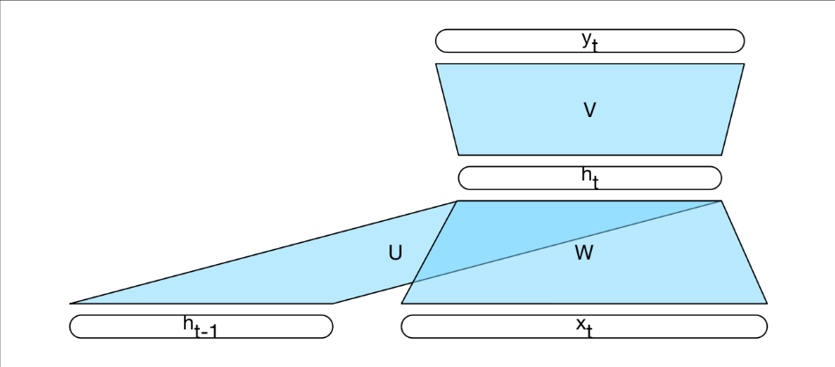
RNN Language Model
To initialize your RNN, you need to determine what are the weights
W or (W_{x}) of shape (D, H)
U or (W_{h}) of shape (H, H)
b (bias) of shape (H,)
V or (W_{y}) of shape (H, V)
b_{y} of shape (V,)
Where
D is the embedding size
H is the hidden state size
V is the vocabulary size

Slide 10
RNN One Step Forward
At each time step, we need to calculate the new hidden state given the previous hidden state and the current input x. The equations are as follows:
a_{t} = W_{h} h_{t-1} + W_{x} x_{t} + b
h_{t} = tanh( a_{t})
In neural networks, we usually feed it with several sentences at the same time as we are working with matrices so we need to think how the sizes will be to make sure our operations are working correctly

Slide 11
RNN One Step Forward
a_{t} = W_{h} h_{t-1} + W_{x} x_{t} + b
h_{t} = tanh( a_{t})
The sizes are as follows:
x_{t} of shape (N, D)
W_{x} of shape (D, H)
h_{t-1} of shape (N, H)
W_{h} of shape (H, H)
b of shape (H,)
a_{t} of shape (N, H)
h_{t} of shape (N, H)
Where N is the batch size
Think how to order these matrices for correct output
Matrix multiplication is done using np.dot()

Slide 12
RNN Gradients Calculations
In training process, our goal is to calculate the gradient of the total loss with respect to all model weights to do the optimization
Since the path has many operations, we use the chain rule and calculate all partial gradients.
Our final goal is to calculate the following gradients
dLoss/dW_{x}
dLoss/dW_{h}
dLoss/db
dLoss/dW_{y}
dLoss/db_{y}

Slide 13
RNN One Step Backward
a_{t} = W_{h} h_{t-1} + W_{x} x_{t} + b
h_{t} = tanh( a_{t})
Since we are now looking only in one step, we will assume that dLoss/dh_{t} will be given
Now let’s work backward
dh_{t}/da_{t} = 1 - tanh²(a_{t}) = 1 - h_{t}²
da_{t}/dh_{t-1} = W_{h}^{T}
da_{t}/dW_{h} = h_{t-1}^{T}
da_{t}/dW_{x} = x_{t}^{T}
da_{t}/db = 1

Slide 14
RNN One Step Backward
Now we can use chain rule as follows:
dLoss/da_{t} = dLoss/dh_{t} * dh_{t}/da_{t}
dLoss/dh_{t-1}= dLoss/da_{t} * da_{t}/dh_{t-1}
dLoss/dW_{h} =dLoss/da_{t} * da_{t}/dW_{h}
dLoss/dW_{x} =dLoss/da_{t} * da_{t}/dW_{x}
dLoss/db = dLoss/da_{t} * da_{t}/db
What about the sizes??

Slide 15
RNN One Step Backward
As you may notices, to calculate the derivatives, we need to cache values from the one step forward as follows:
x_{t}
W_{h}
h_{t-1}
h_{t}

Slide 16
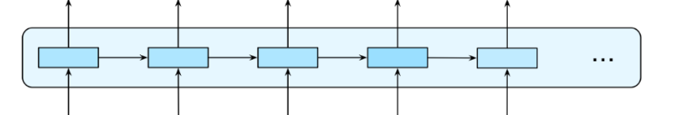
RNN Full Forward Pass
To make the full pass we need to do the following:
Create a matrix h that will be filled with all hidden states with size (N, T, H)
T is the size of sequence sentences
Loop over T and calculate one step forward with each input value
Cache all values in a list for the backward pass

Slide 17
RNN Full Backward Pass
This backward pass will calculate gradients dW_{x}, dW_{h}, db
The function will assume that dLoss/dh of shape (N, T, H) will be given to it
Loop over T and call one_step_backward with the appropriate parameters
All gradients returned for Wx, Wh and b should be added
Return the final gradients
To pass the correct dh look at this figure

Slide 18
Hidden to Scores Forward
Till now we produced all hidden states having a matrix of shape (N, T, H)
For a Language model we need to produce scores for all words in our vocabulary
This can be done using another layer with the following equation
y = W_{y} h + b_{y}
Again what about sizes??

Slide 19
Hidden to Scores Backward
Here we assume we are given the gradient of loss with respect to scores (y) with the shape (N, T, V)
y = W_{y} h + b_{y}
The derivates will be as follows
dLoss/dh = dLoss/dy * dy/dh = dLoss/dy * W_{y}^{T} → This one will be given to full backward pass
dLoss/dW_{y} = dLoss/dy * dy/dW_{y} = ((dLoss/dy)^{T} * h)^{T}
dLoss/db_{y} = dLoss/dy * dy/db_{y} = dLoss/dy (with summing)
Again what about sizes??

Slide 20
Softmax Loss
Now, since we have the scores we need to calculate the cross entropy loss.
This one will be implemented for you producing the loss as a scalar and dLoss/dy of shape (N, T, V)

Slide 21
Putting All Together
You will put all the previous components together in one big loss function that calculates the forward pass producing the total and all caches. Then you will do the full backward pass to produce all the gradients with respect to all model weights.
The function will return the following:
Loss
Gradients
The gradients of course will be used to update the model parameters using the gradient descent algorithm.

Slide 22
Language Models Applications
Prediction
Given a sequence of tokens you can use a language model to generate the probability distribution over your vocabulary then pick the token with the maximum probability
Generation
Since the language model produce a probability distribution over words, this distribution can be used for random sampling so generating different outcomes while preserving the LM probability distribution
The sampling can be done in numpy using np.random.choice

